Slide 1
Module 1: Lesson 2 – GNSS Positioning Errors
Notes:
A well designed GPS receiver can achieve a horizontal accuracy of 3 meters or better and a vertical accuracy of 5 meters or better 95% of the time. Augmented GPS systems (the topic of a future lesson) can provide sub-meter accuracy. But that’s still not perfect.
Ask Students:
Q: what reasons can you think of that would cause a GPS receiver to have errors?

Slide 2
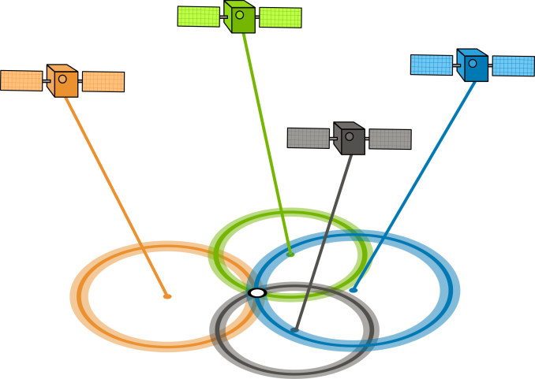
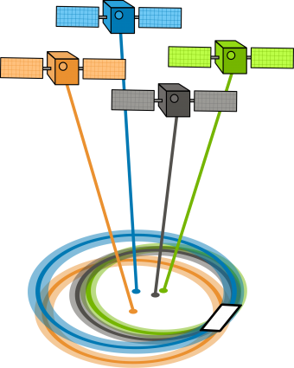
DOP – Dilution of Precision
GDOP (geometric dilution of precision) or PDOP (position dilution of precision) describes the error caused by the relative position of the GPS satellites
Good DOP (low)
Bad DOP (high)
Notes:
Dilution of Precision is a numerical metric calculated by the GPS receivers
Basically, the more signals a GPS receiver can “see” clearly (spread out vs close together), the more precise it can be. If, from the observer's point of view, the satellites are spread out in the sky, then the receiver has a good DOP. But, if the satellites are close together, then you have a poor DOP which could potentially lower the quality of your GPS positioning by meters
Ask Students:
Q: What would happen if you are using autosteer in a tractor and your GPS position is off by meters?

Slide 3
DOP values
1 or less: Ideal view of the sky with a strong satellite density
1-2: Excellent for all agricultural applications
2-5: Good for most applications, may induce guidance errors
5-10: Moderate satellite density, not recommended for agriculture applications
10+: Very Poor satellite visibility
Notes:
For agriculture application, particularly those that only use GPS (not Russia’s GLONASS or other GNSS solutions) we will typically have DOP values anywhere from 1 to 3. Getting to a DOP of 1 or less is very difficult unless you are using more than 1 GNSS solution (GPS and GLONASS) A DOP greater than 5 is generally not recommended for agriculture applications.

Slide 4
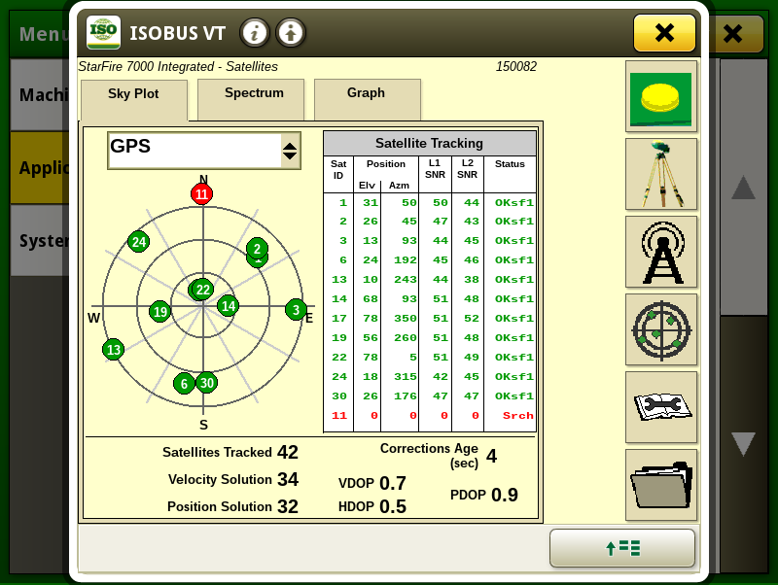
Viewing DOP
VDOP (Vertical DOP) = 0.7
HDOP (Horizontal DOP) = 0.5
PDOP (Position DOP) = 0.9
Ideal View of the sky
Notes:
This is a screenshot from a John Deere display. On the left, there is a graphic of the locations of the satellites that are being tracked. Imagine you are standing in the center, and you look up, that is where the satellites are in the sky above you.
We can also see that we are tracking 42 satellites (from multiple GNSS solutions) but we are only using 32. that means that 10 satellites are being tracked but not used. For some reason, the GPS receiver does not think that they should be used but it will continue to track them.

Slide 5
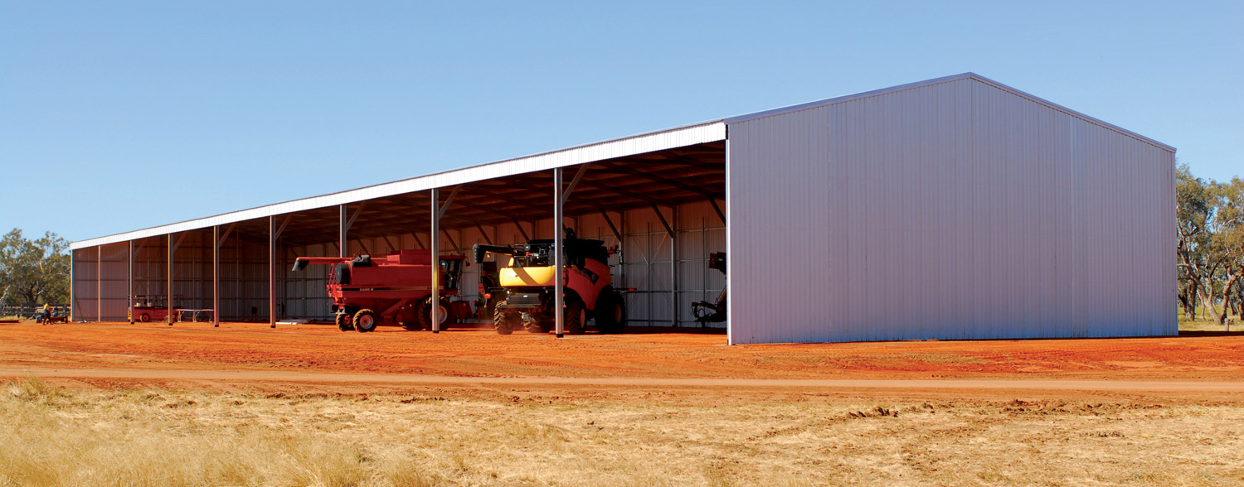
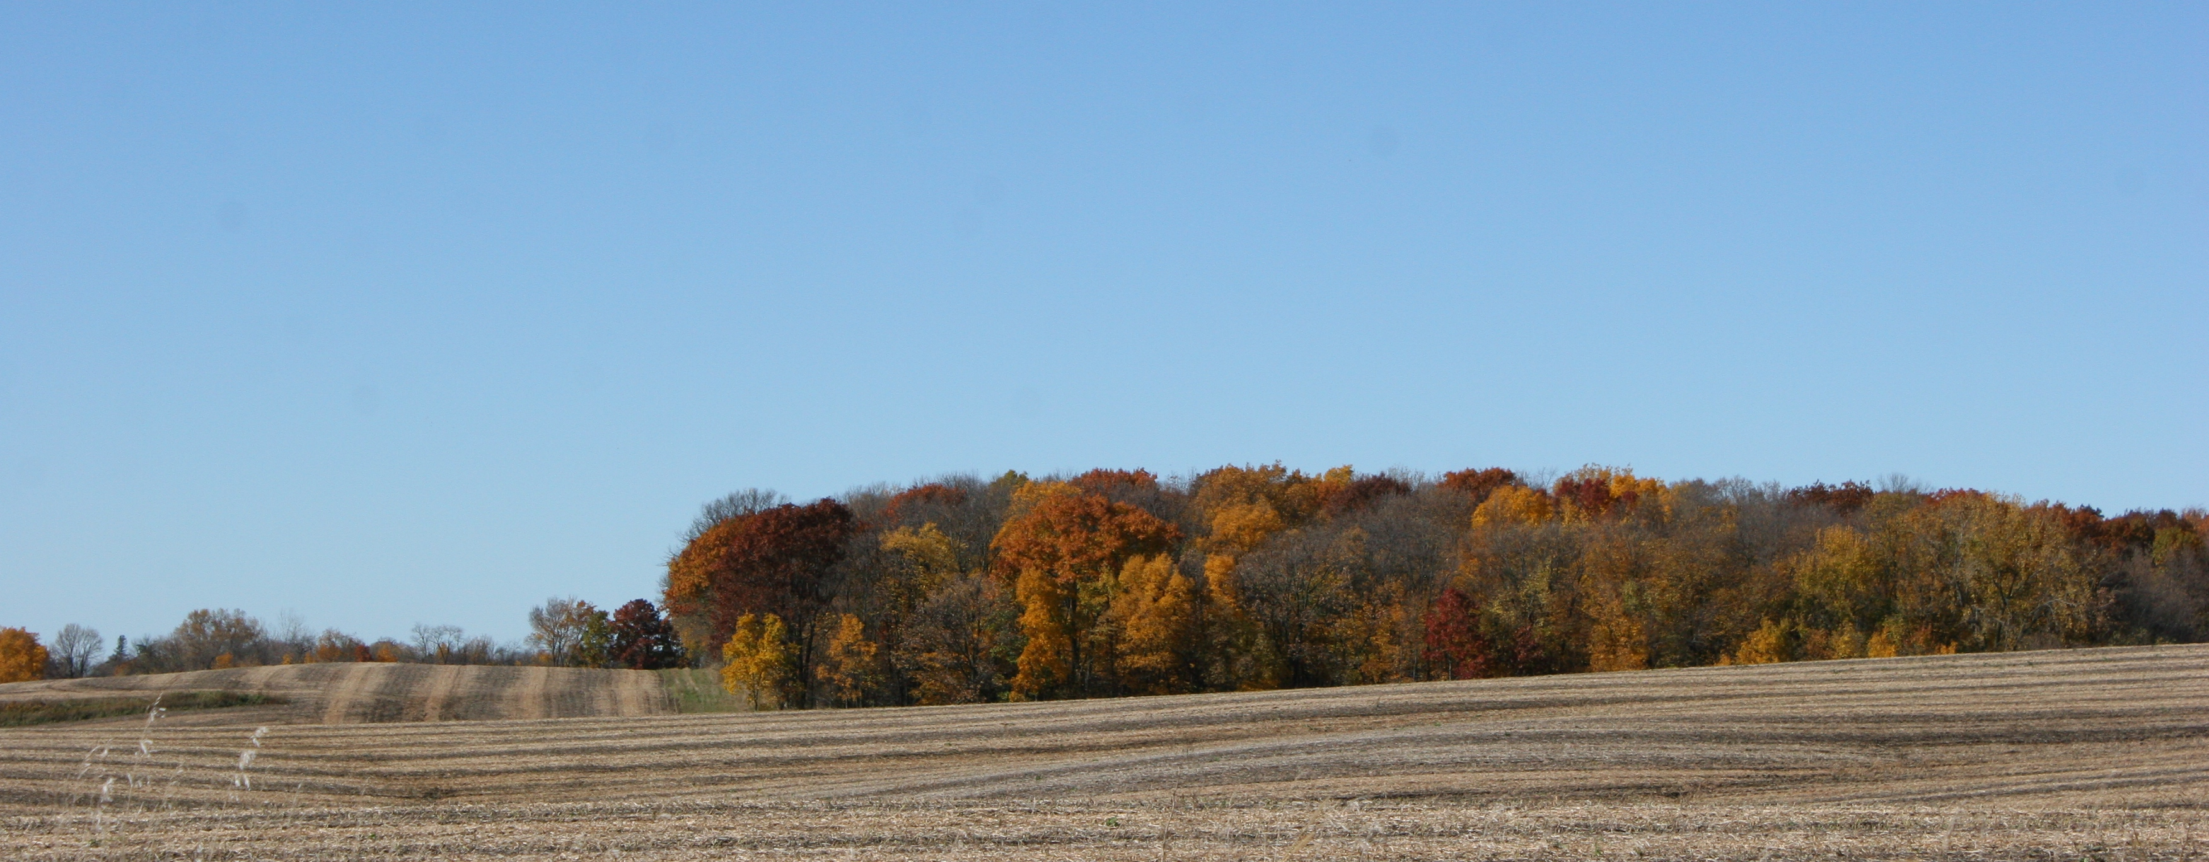
Physical Barriers
Barriers (like tree lines or buildings) can physically block satellite signals from reaching the antenna
Notes:
Physical barriers is one of the most common culprits when it comes to GPS errors. We power, be able to “see” the satellites in the sky to be able to get a signal from them. GPS signals are very faint and very low power. They have virtually zero capability to penetrate physical objects. This is why the GPS receiver on a tractor will not pick up any signals from satellites if the tractor is parked inside of a shed.
In agriculture, it is not uncommon to farm very close to a tall tree line or a large building. These physical barriers will block any satellite signals from reaching the GPS antenna on the tractor.

Slide 6
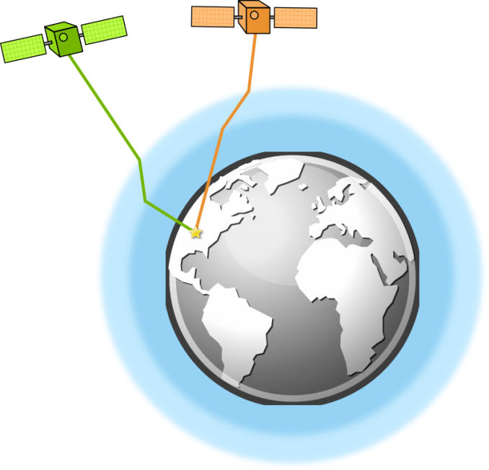
Atmospheric Interference
Different layers of the atmosphere can cause GPS signals to refract or bounce around. Causing a delay in the delivery of the signals from the satellite to the receiver.
Notes:
In order for GNSS systems to work, we rely on the GPS signal to travel in a straight line from the satellites to the receiver. Various layers of the atmosphere can have cause GPS signals to bounce or refract, causing there to be a delay in the time it takes to signal to reach the receiver. When this happens, we are going to miscalculate the time and/or distance from the receiver to the satellite. This effect is the most predominant in the highest levels of the atmosphere. Local atmospheric events (example: thunderstorms) can also impact how the atmosphere interacts with GPS signals.
To fix this, GPS can use two separate frequencies to minimize the error.

Slide 7
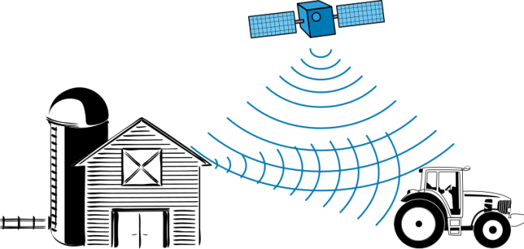
Multipath interference
Occurs when GPS signals bounce off nearby structures like buildings
Could cause a GPS receiver to detect the same signal twice
Notes:
Multipath interference happens more in urban areas than rural, agricultural areas but it does still happen, especially around large (particularity metal) structures. As we move away from the structure, the error alleviates.

Slide 8
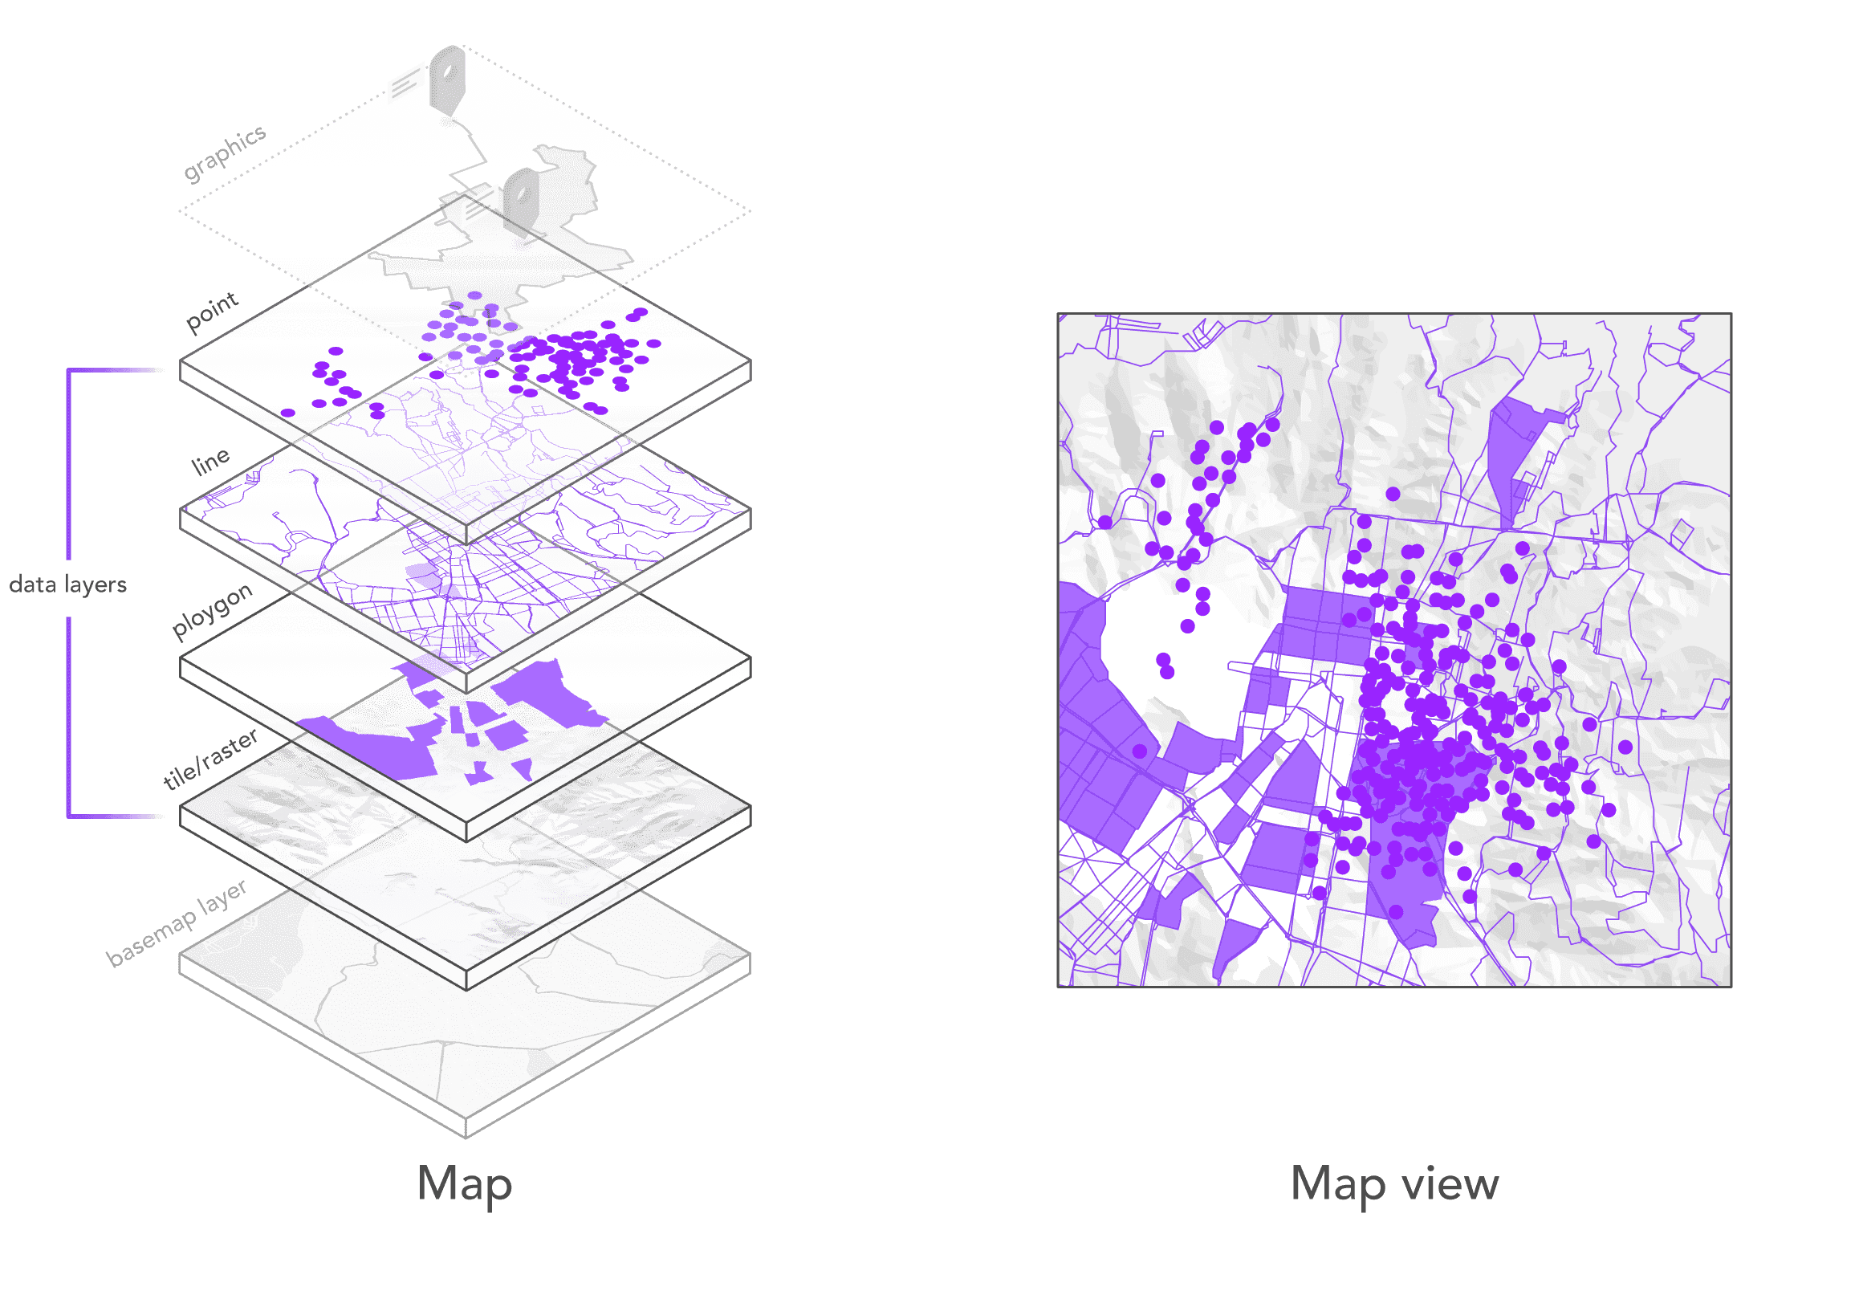
Physical Barriers

